Slide 1
Object Oriented Programming

Slide 2

Java Constructor

Slide 3
Constructor
A constructor in Java is a block of code similar to a method that's called when an instance of an object is created.
Here are the key differences between a constructor and a method: A constructor doesn't have a return type.
The name of the constructor must be the same as the name of the class.

Slide 4
Rules for creating java constructor
There are basically two rules defined for the constructor.
Constructor name must be same as its class name
Constructor must have no explicit return type
The constructor gets called when we create an object of a class

Slide 5
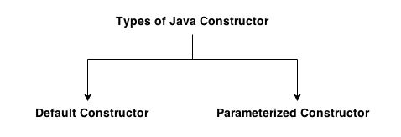
Types of java constructors
There are two types of constructors:
Default constructor (no-arg constructor)
Parameterized constructor

Slide 6
Java Default Constructor
A constructor that have no parameter is known as default constructor.
Syntax of default constructor:
<class_name>()
{
………….
}

Slide 7
Example of default constructor
class Bike1{
Bike1() {
System.out.println("Bike is created");
}
public static void main(String args[]) {
Bike1 b=new Bike1();
}
}

Slide 8
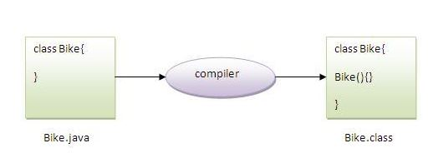
default constructor
Rule: If there is no constructor in a class, compiler automatically creates a default constructor.
Default constructor provides the default values to the object like 0, null etc. depending on the type.

Slide 9

Java parameterized constructor
A constructor that have parameters is known as parameterized constructor.
Parameterized constructor is used to provide different values to the distinct objects.

Slide 10
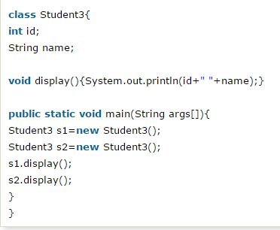
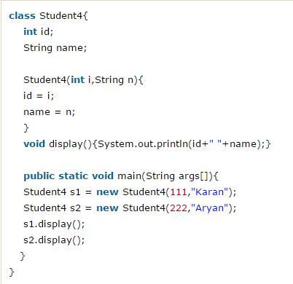
Example

Slide 11
Constructors
A constructor initializes an object immediately upon creation.
It is similar to a method and has same name as the class in which it resides.
It has no return type not even void.
Once defined it is automatically called immediately after the object is created.
When there is no explicit constructor for a class, then java creates a default constructor for that class.
The default constructor automatically initializes all instance variables to 0.

Slide 12
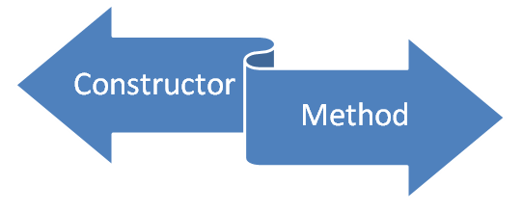
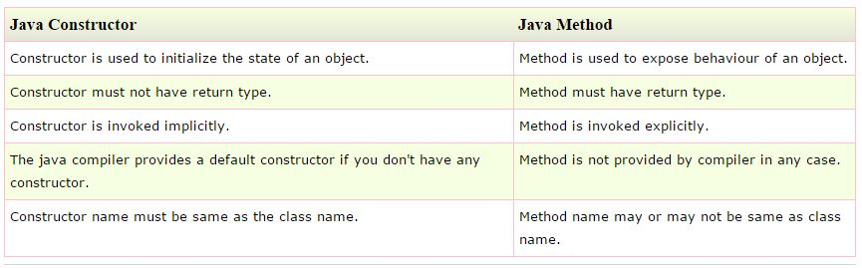
Difference between constructor and method

Slide 13
Unified Modeling Language (UML)
UML is for visualizing, specifying, constructing and documenting the components of software and non software systems.
UML notations are the most important elements in modeling.

Slide 14
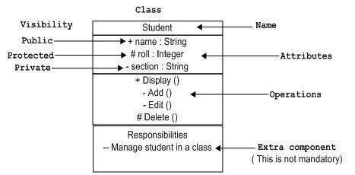
Class Notation:
UML class is represented by the diagram shown below. The diagram is divided into four parts.
The top section is used to name the class.
The second one is used to show the attributes of the class.
The third section is used to describe the operations performed by the class.
The fourth section is optional to show any additional components.

Slide 15
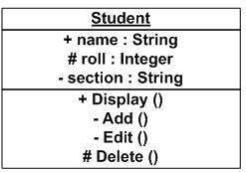
Object Notation:
The object is represented in the same way as the class. The only difference is the name which is underlined as shown below.

Slide 16
UML(Structural Things)
Graphical notations used in structural things are the most widely used in UML. These are considered as the nouns of UML models. Following are the list of structural things.
Classes
object
Interface
Collaboration
Use case
Active classes
Components
Nodes

Slide 17
Basics of UML Class Diagrams
What is a UML class diagram?
Imagine you were given the task of drawing a family tree. The steps you would take would be:
Identify the main members of the family
Identify how they are related to each other
Find the characteristics of each family member
Determine relations among family members
Decide the inheritance of personal traits and characters

Slide 18
Basics of UML Class Diagrams
By definition, a class diagram is a diagram showing a collection of classes and interfaces, along with the collaborations and relationships among classes and interfaces
A class diagram is a pictorial representation of the detailed system design

Slide 19
Basics of UML Class Diagrams
A UML class diagram is similar to a family tree.
A class diagram consists of a group of classes and interfaces reflecting important entities
The relationships between the classes are analogous to relationships between members in a family tree.
Interestingly, classes in a class diagram are interconnected in a hierarchical fashion.

Slide 20
Basics of UML Class Diagrams
When you designed the use cases, you must have realized that the use cases talk about "what are the requirements" of a system.
The aim of designing classes is to convert this "what" to a "how" for each requirement

Slide 21
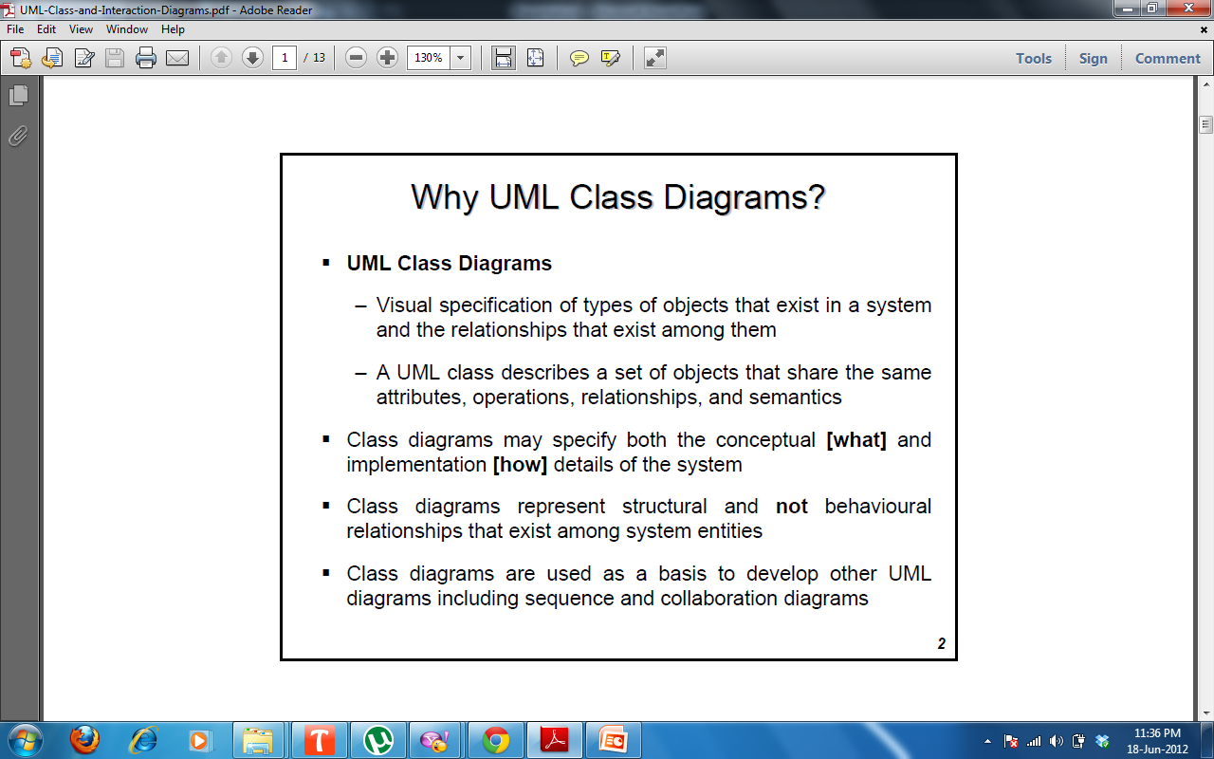

Slide 22
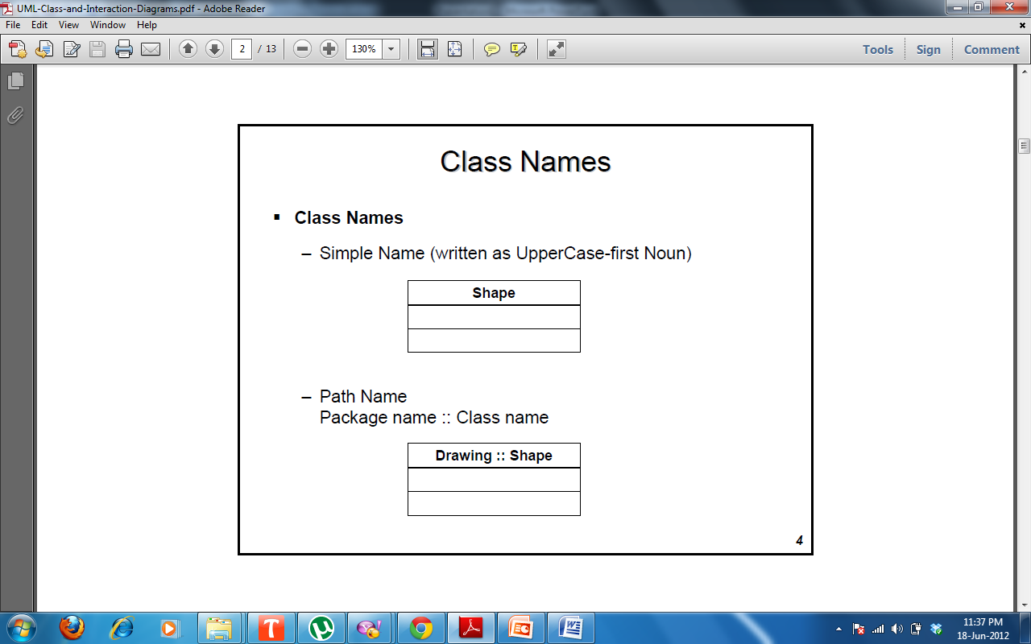

Slide 23
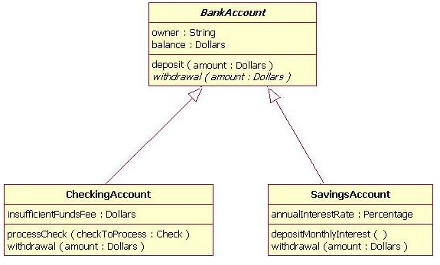
UML Example

Slide 24
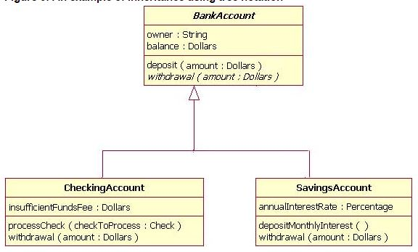
UML Example

Slide 25
Assignment
Java Program to check Greater between the Two Number
Java Program to Reverse the Given Number
Java Program to Print Number in the Given Data Type
Program to find whether entered character is a vowel or Consonant
Java Program to Calculate the Sum of Digits of Given Number
To Find Whether Given Year is a Leap Year or not

Slide 26
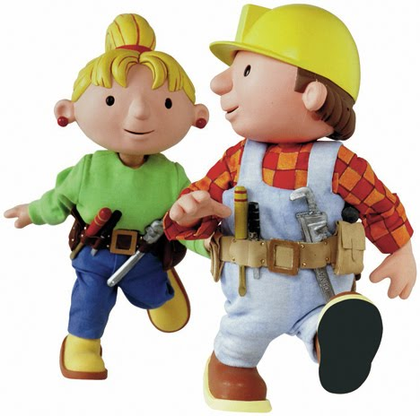
Thank You

